Slide 1

Presented by:
Bridgid Johnson
Client Solutions Manager, mardevdm2

Slide 2
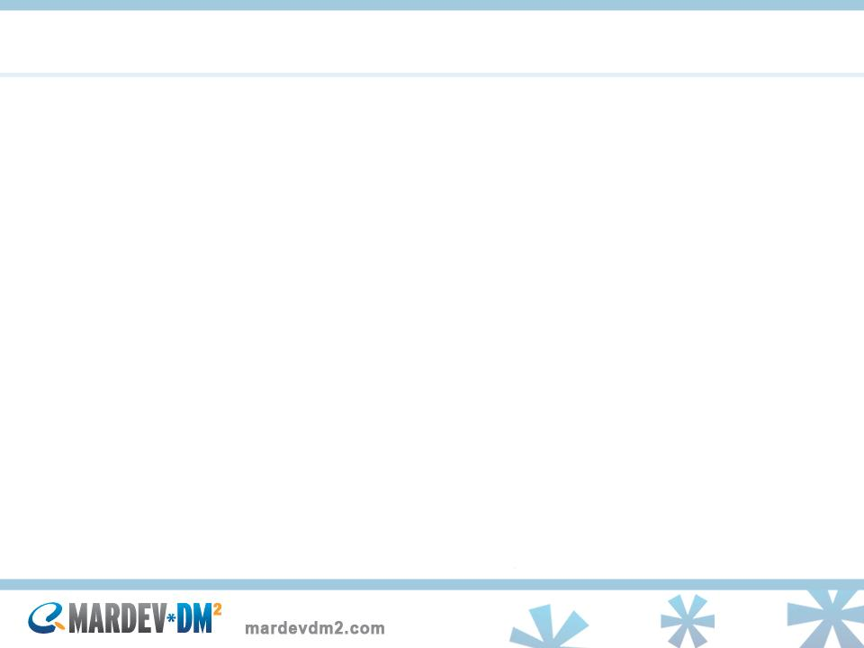
What does the md2 Client Solutions Team do?
mardevdm2’s Eloqua Certified Client Solutions Team provides technical and analytical support for Demand Generation Programs through Marketing Automation to better leverage and scale integrated marketing communications to maximize return on investments.

Slide 3
mardevdm2 Achievements
Segmentation & Analytics
SmartStart w/Branding & Deliverability
Advanced Co-Dynamic Lead Scoring Model
Advanced CRM Integration (SFDC) and Lead Management
Custom Hypersites with Content Substitutions
Gated Forms w/CRM integration
Custom Messages creation with ADC
External Form integration
Tracking Scripts on External Websites
Multi-touch tracking with PURLs
Custom Dashboards
Forward to a Friend Links
Best Practice & Compliance Coaching
Closed-Loop Reporting

Slide 4
mardevdm2’s Approach
Predictable Quality and On-time delivery of results
Consultation call with the client
Detailed Statement of Work which details
  Scope
  Deliverables
  Project Plan/Timelines
  Prerequisites
  Pricing

Slide 5
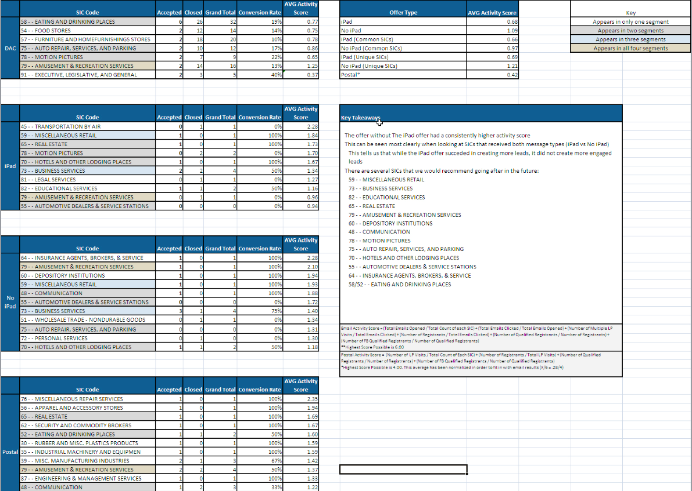
Propensity Model

Slide 6
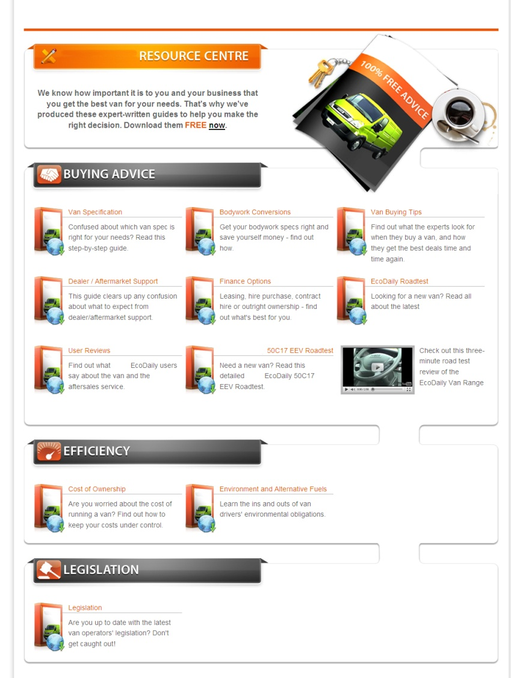
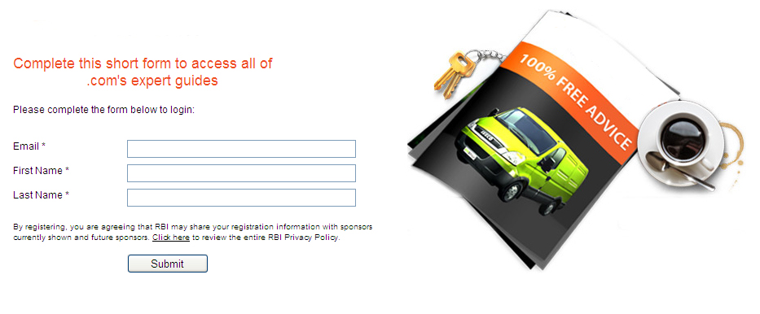
Hypersite: Multi-touch Driven

Slide 7
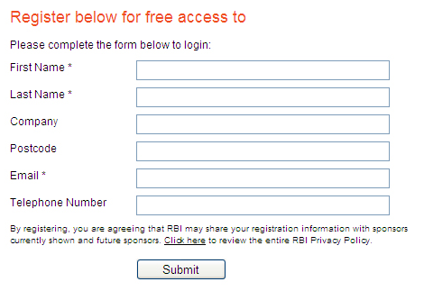
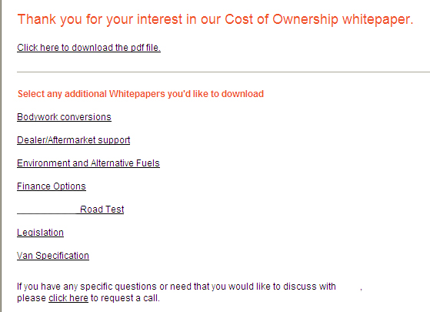
Gated Form to Download Assets

Slide 8
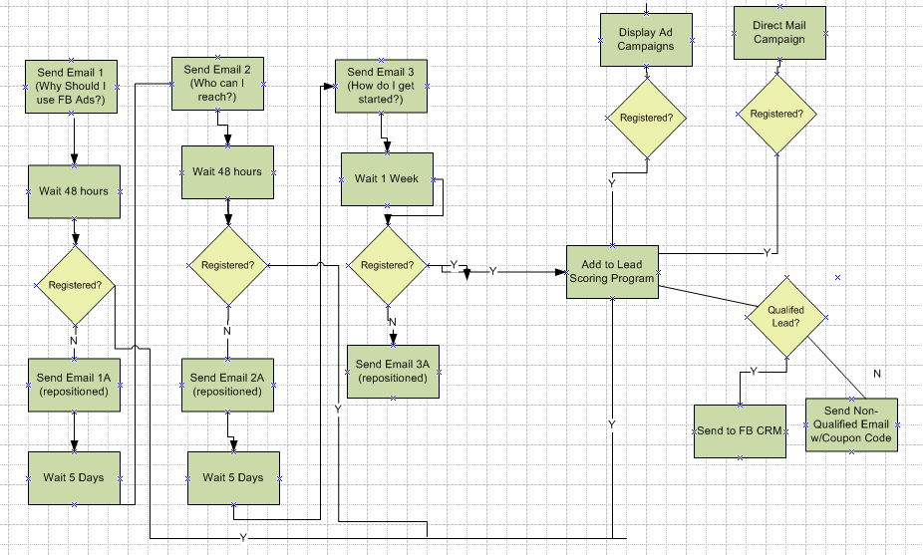
Lead Generation Program

Slide 9
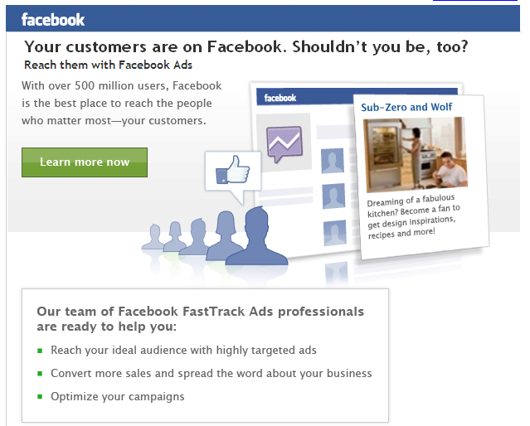
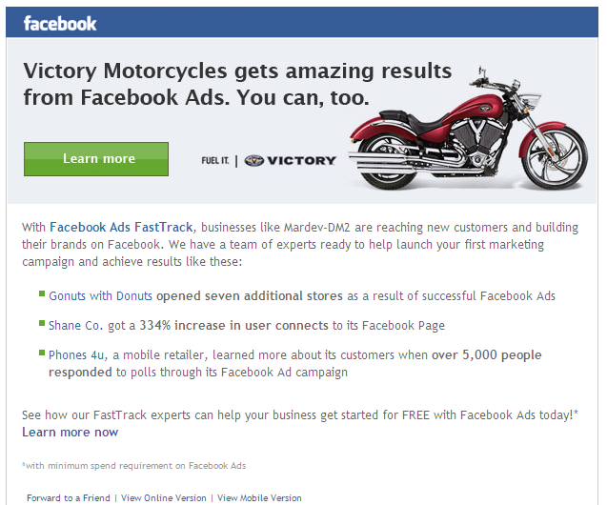
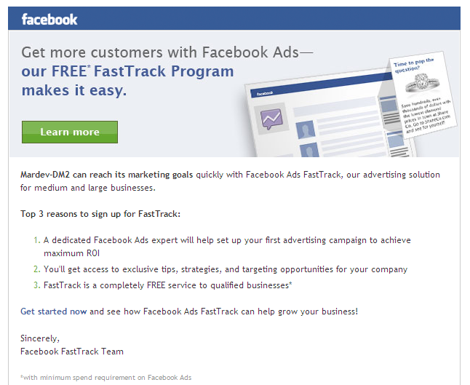
Custom Emails w/ADC
Notes:
Problem with lead generation – only 5% ready to purchase; campaigns therefore generate a high # of leads that are not ready to purchase at this point in time but could do in the future. Soln #1 : work sales harder or 2 – nurturing.
Marketing Automation System is a single, integrated platform that supports ‘prospect / customer life cycle management ‘– awareness through to purchase in an automated way through behavioural based targeting according to cookies and behavioural data. It supports perpetual marketing, building a relationship with the respondent over a period of time.
PROFITABLE MARKETING: allows us to drive more leads out of existing campaigns – leveraging the maximum value from our marketing investment.
Marketing Strategy:
Build and execute complex, triggered campaigns that leverage all customer contact history, behavioral analysis and profiled data to target precisely those customers and prospects most likely to buy our products and services. Automate the qualification, assignment and routing of all leads, effectively extending our sales force automation applications. Automate all inbound queries and outbound responses, cutting response times to seconds and ensuring that all customer and prospect data is captured and leveraged in future campaigns

Slide 10
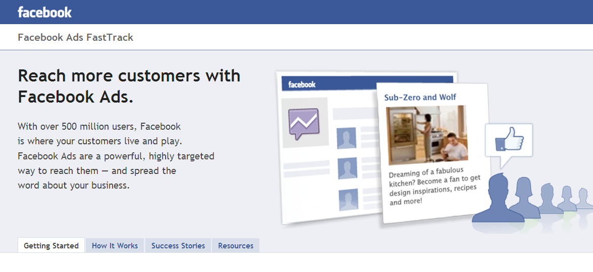
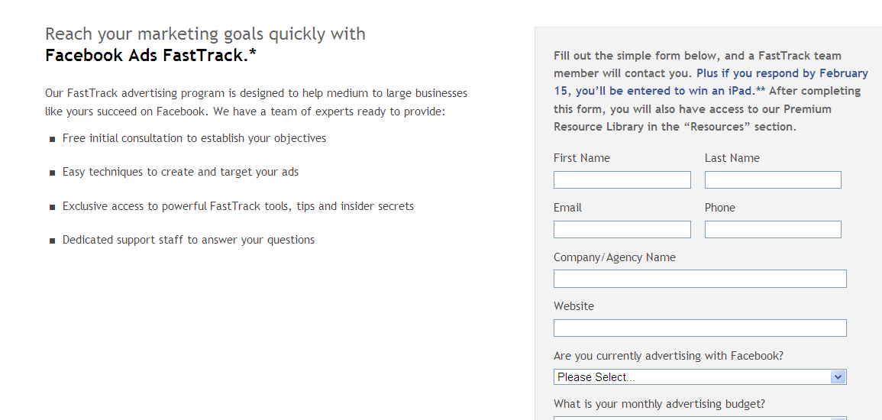
Hypersite with Content Substitution and Form

Slide 11
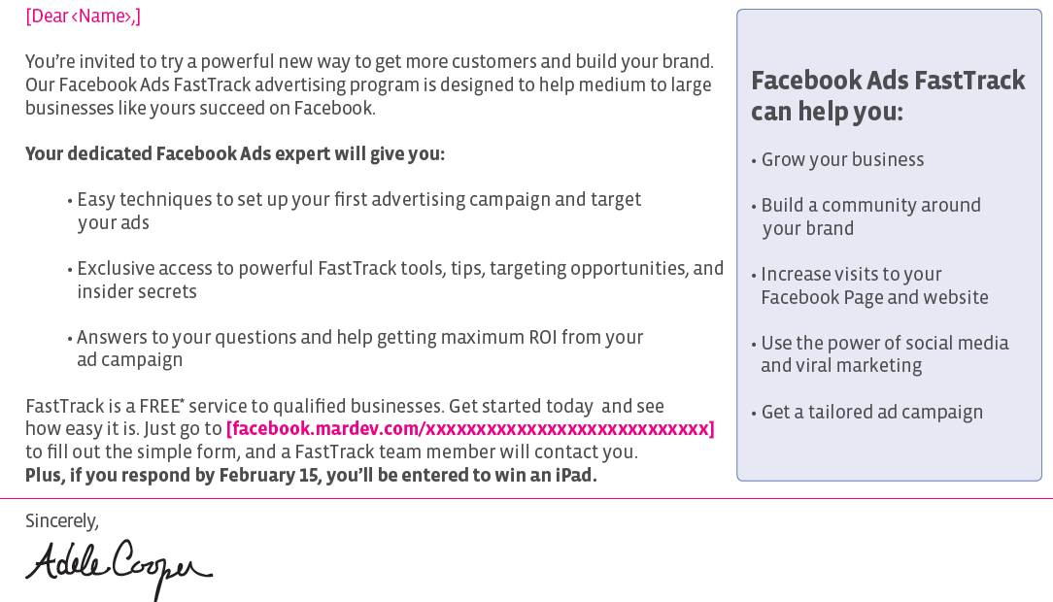
Direct Mail Campaign w/PURL i.e. www.facedbook.mardev.com/BridgidJohnson

Slide 12
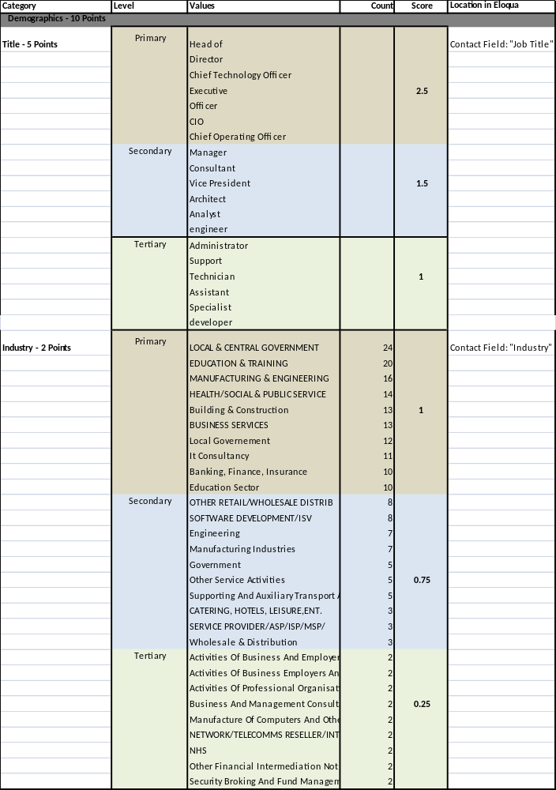
Lead Scoring Model

Slide 13
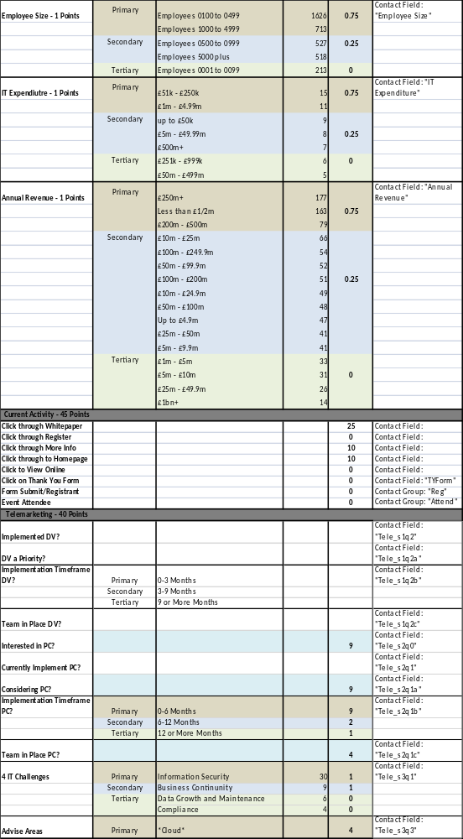
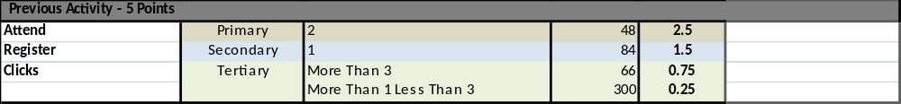
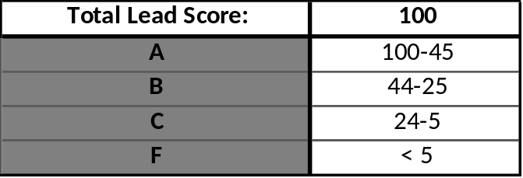
Lead Scoring Model Cont.
Results and total lead score

